Slide 1
Final Presentation
SENG310 - Human Computer Interaction
Junhao Lin, Linyao Hou, Mengyang Zhang, Daming Wang, Xinxin Wu
Group #15

Slide 2

Motivation and Goal
Goal
Users can remotely do those Anytime and Anywhere:
Feeding
Cleaning
Interacting
Checking health info
Booking for health test and vaccine
Pets won’t feel lonely
Owners don’t need to be too much worried Anymore.
Motivation
Owners lack of experience
Owners are busy
Pets always stay alone

Slide 3
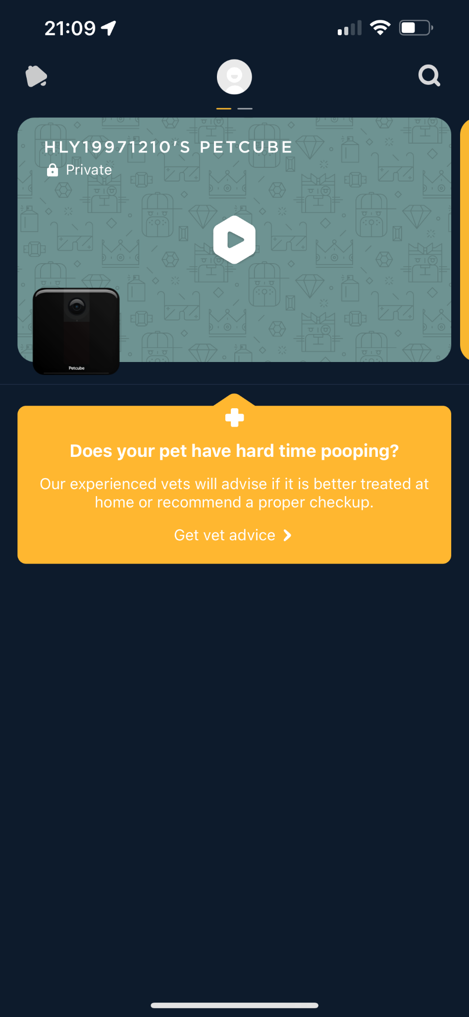
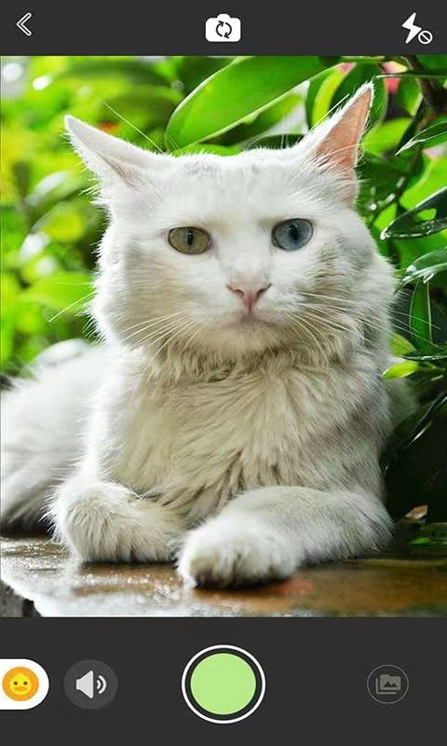
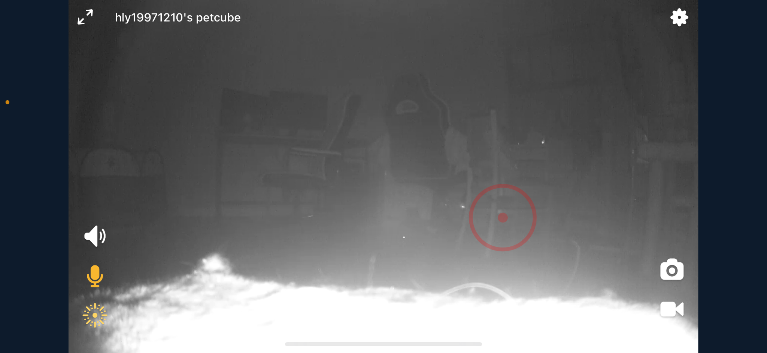
Related works
Image 1.
Mengchongxiangji
Image 3.
Pet Cube
Image 2.
Pet Cube

Slide 4
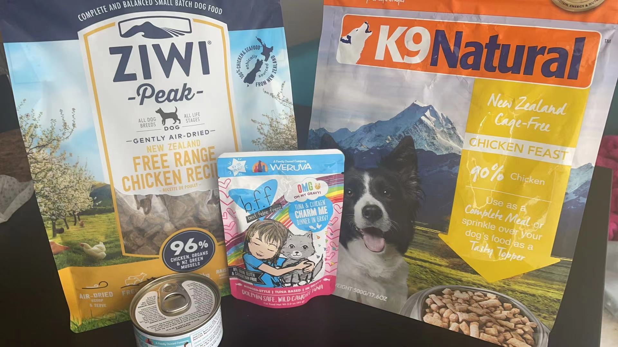
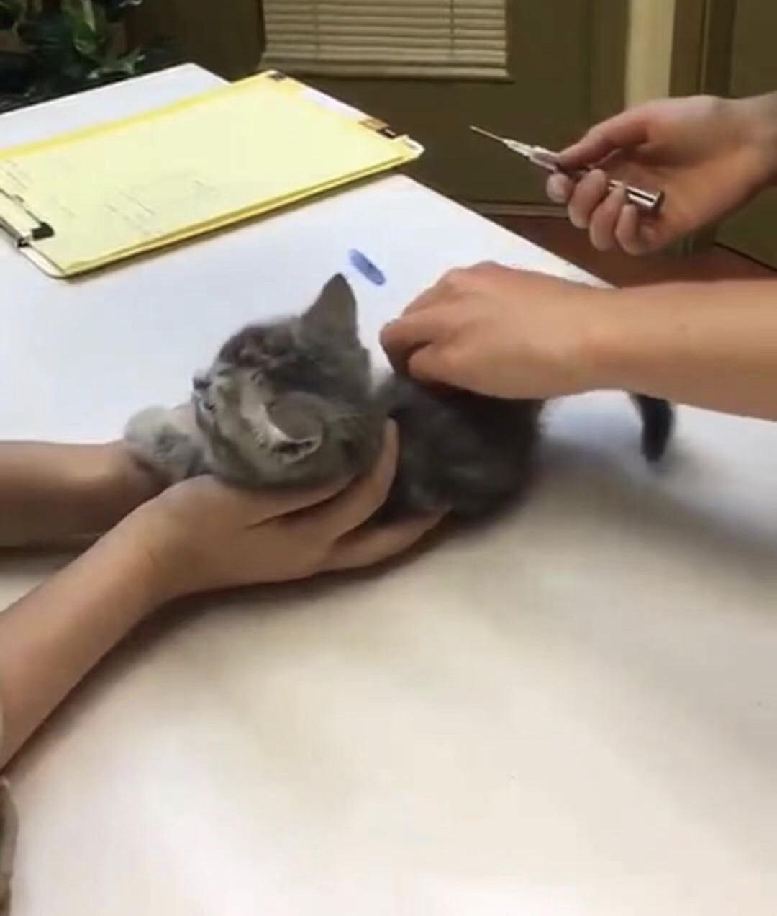
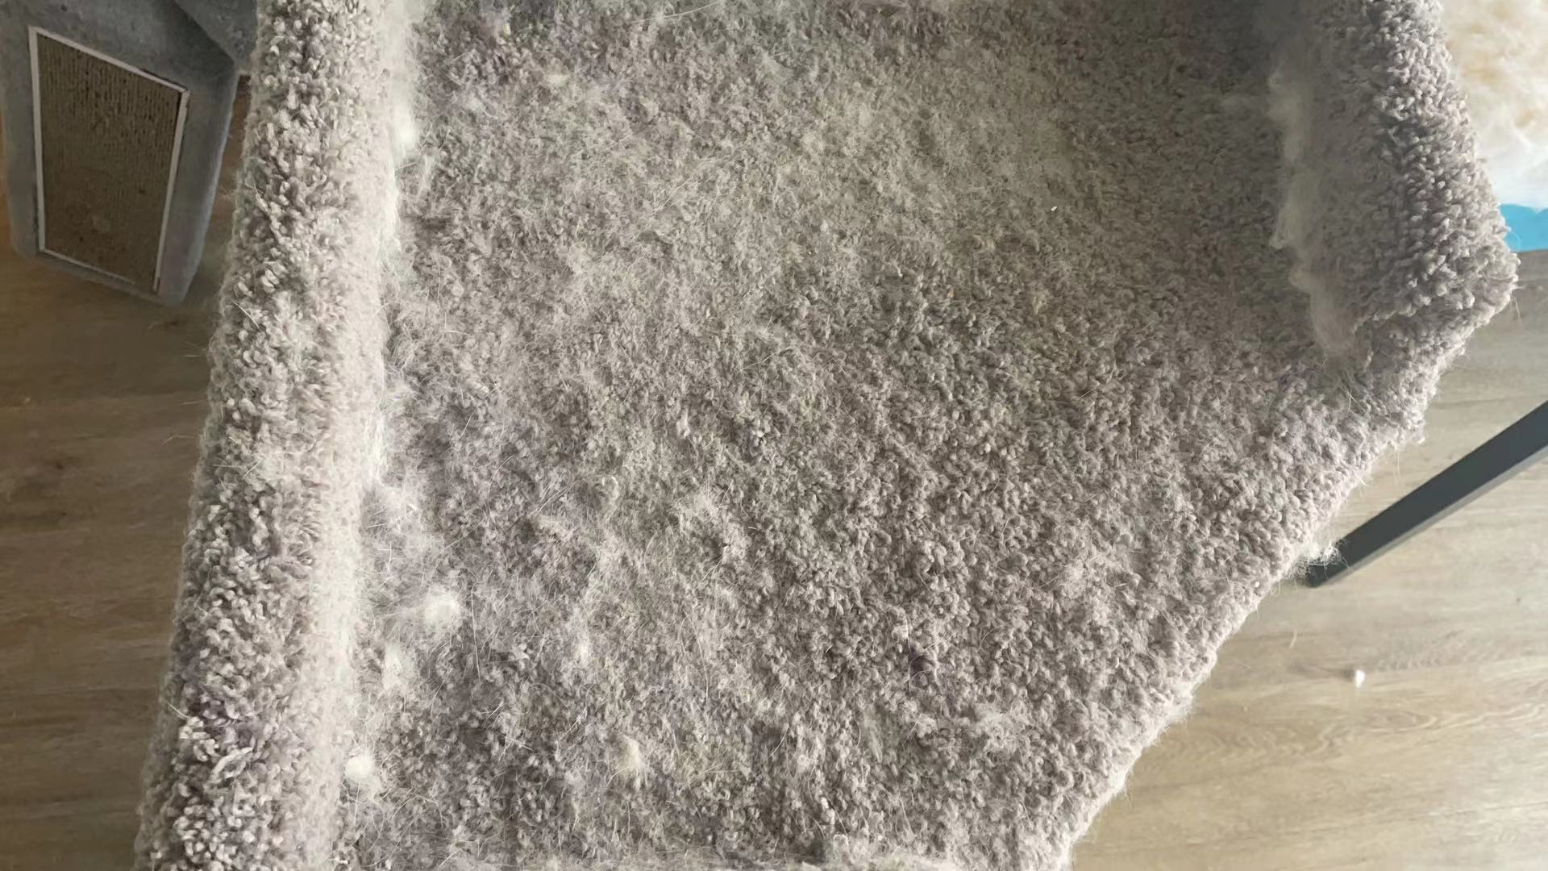
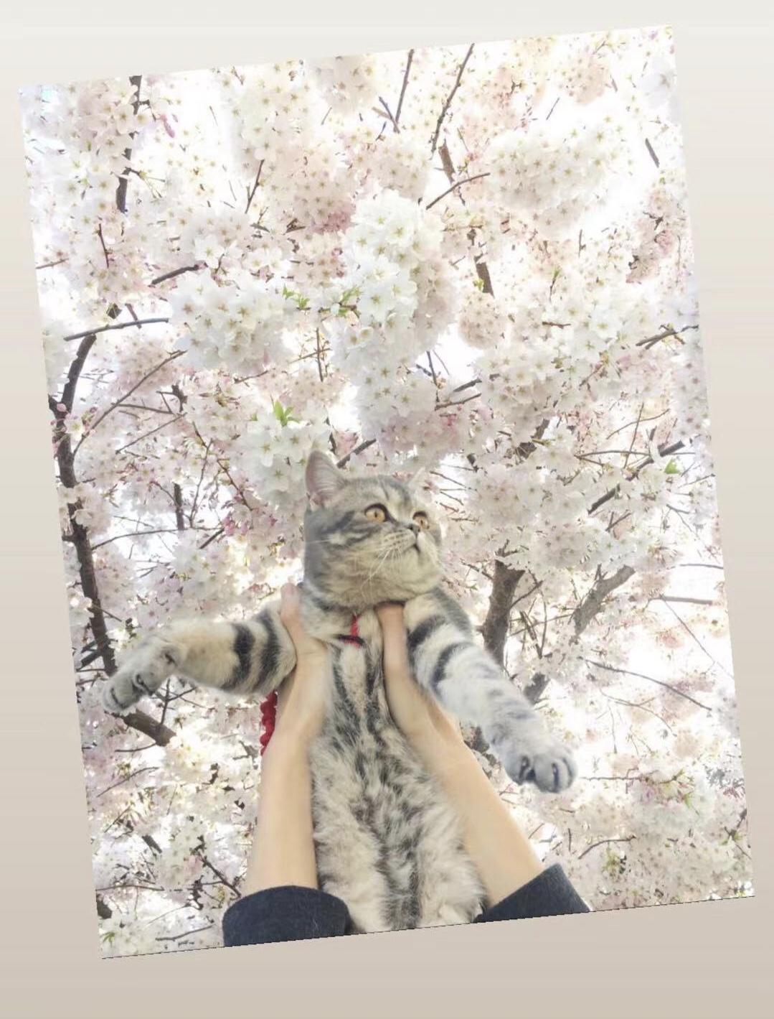
Key user research findings
Should Include:
Pet health Chart
Online advising
Cloud Include:
The platform where users can communicate
Pet rescue center community
Exclude:
Pet trading service
Must Include:
Huge pet database
Auto-feeding function
Pet hair cleaning function
Intelligent advice
Notification function
Real-time monitoring function

Slide 5
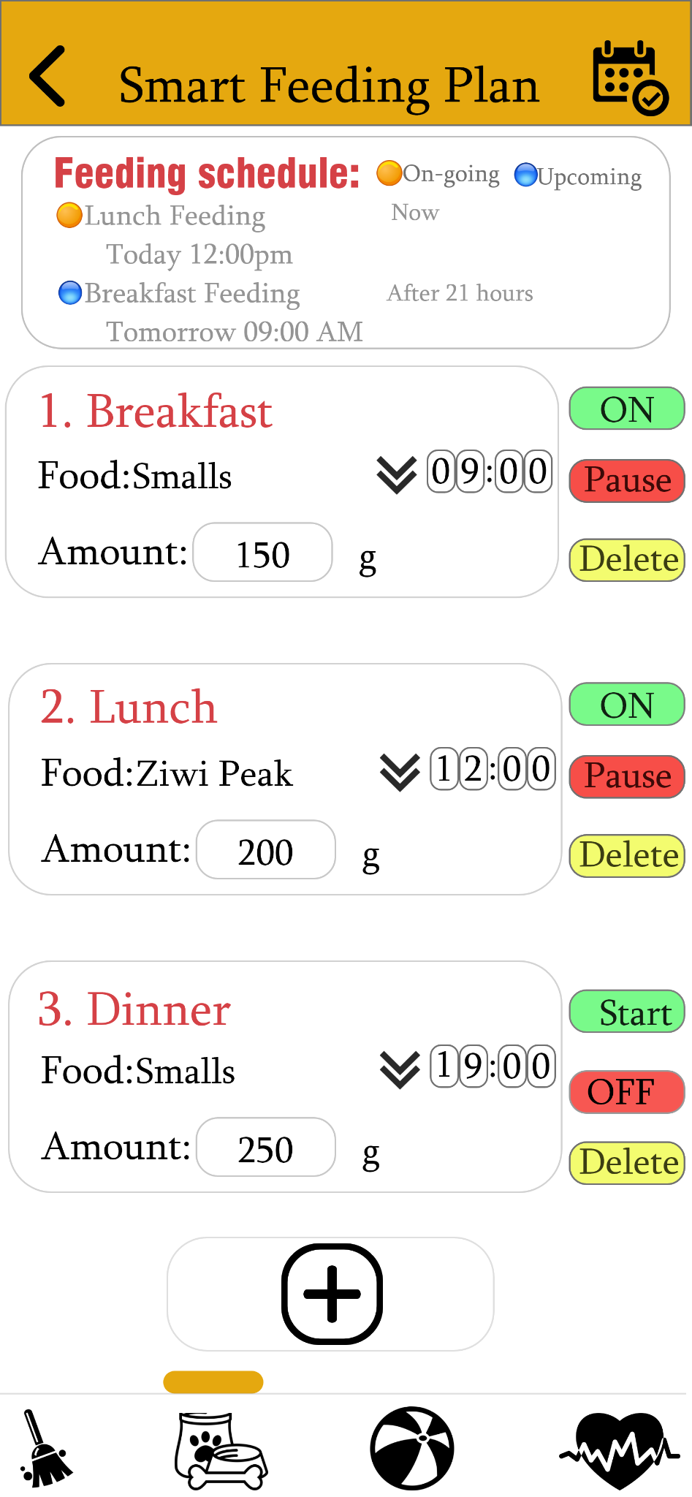
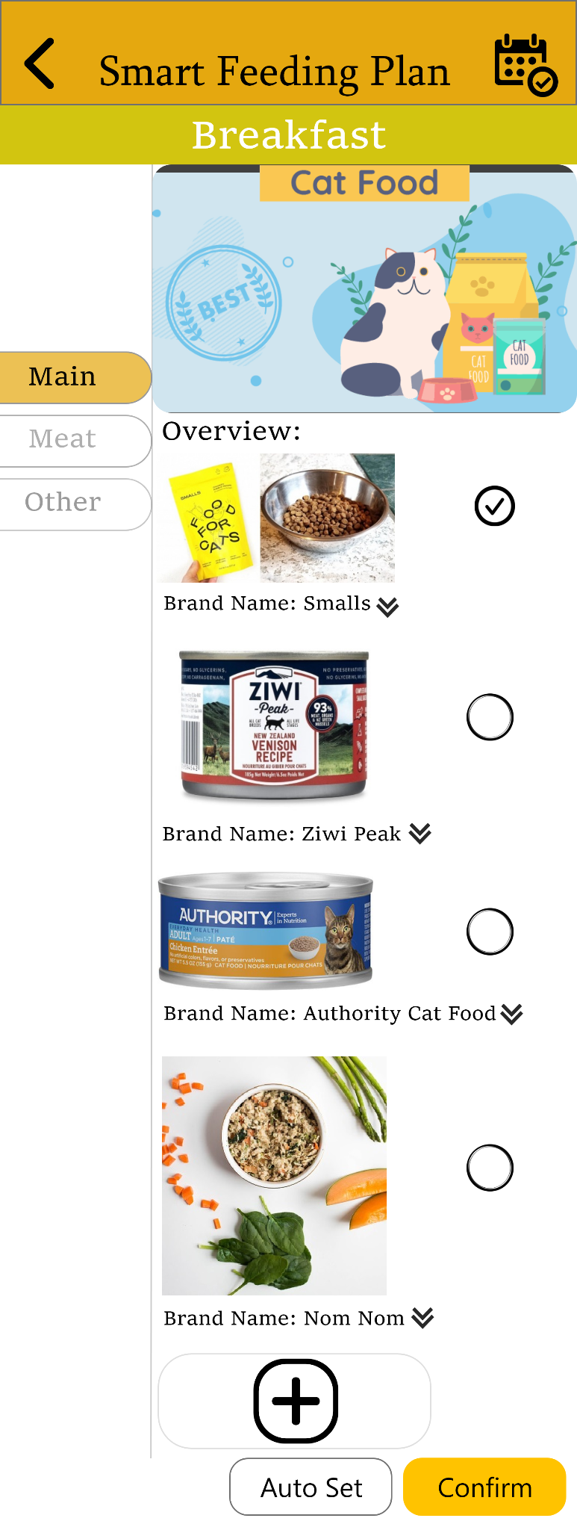
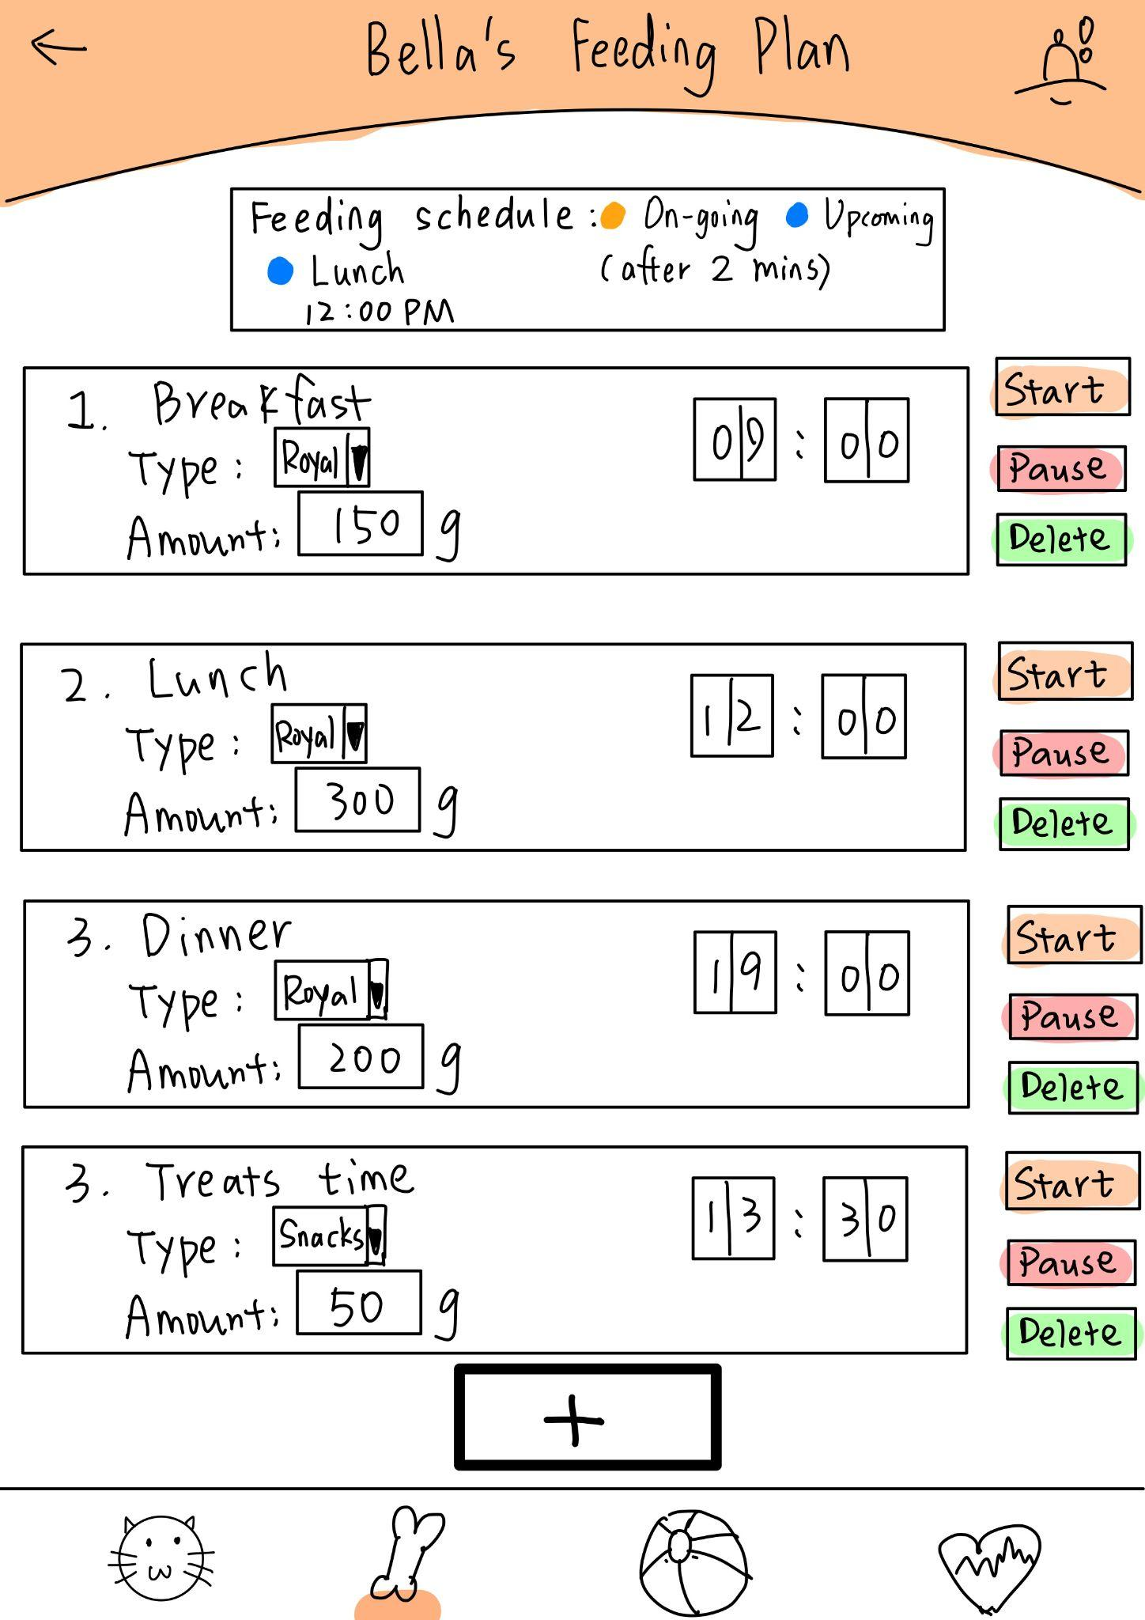
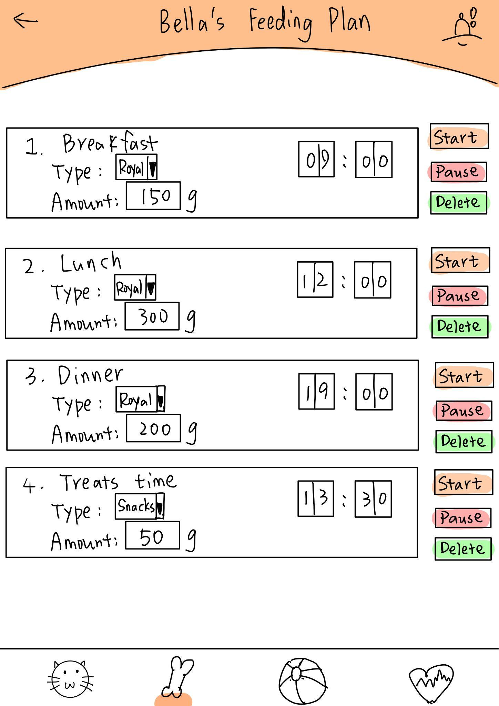
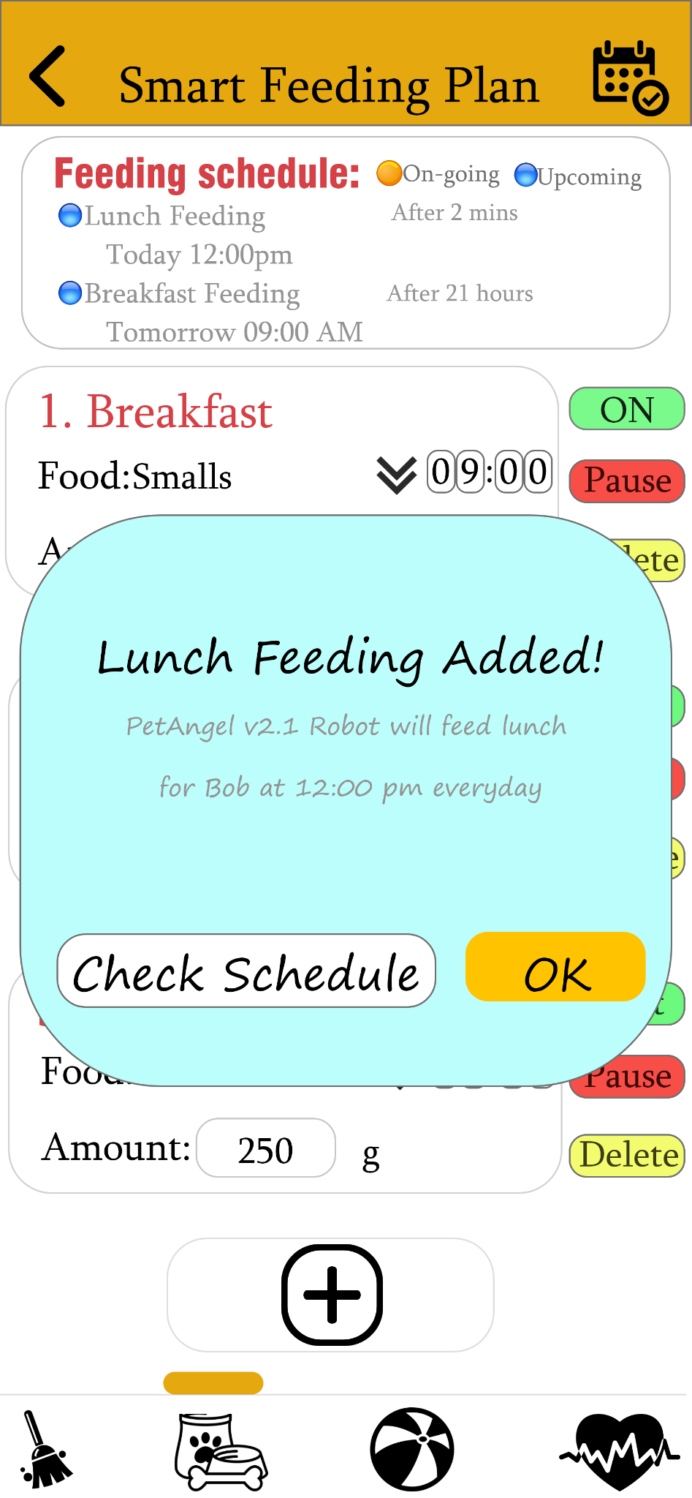

Prototype evolution
First Iteration:
Feeding schedule added
Add more meals function
Second Iteration:
1. Change ‘Reminder’ to ‘Events’
2. Keyword on the Buttons
3. Double Confirm
4. Add ‘Cleaning’ icon at the bottom
5. Menu for each meal

Slide 6
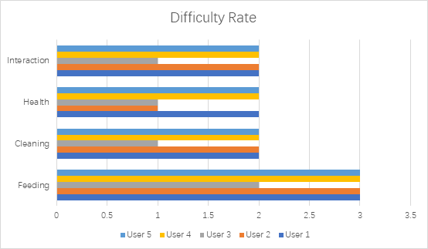
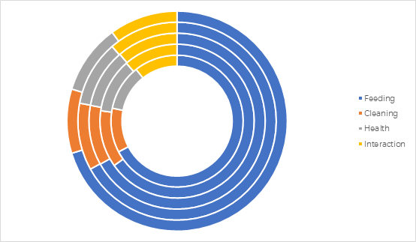
User Evaluation Results
The feeding part of our interface is too complicated

Slide 7
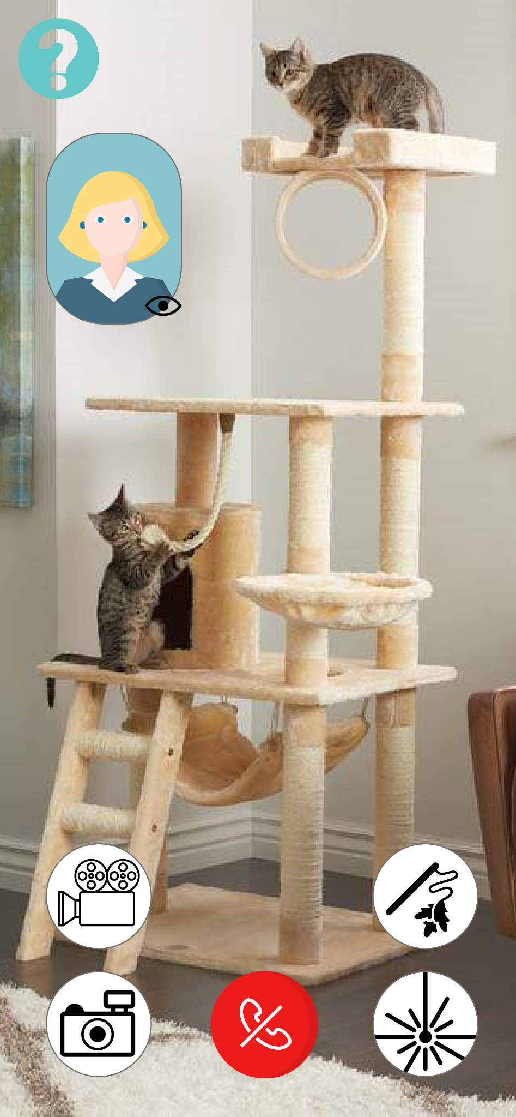
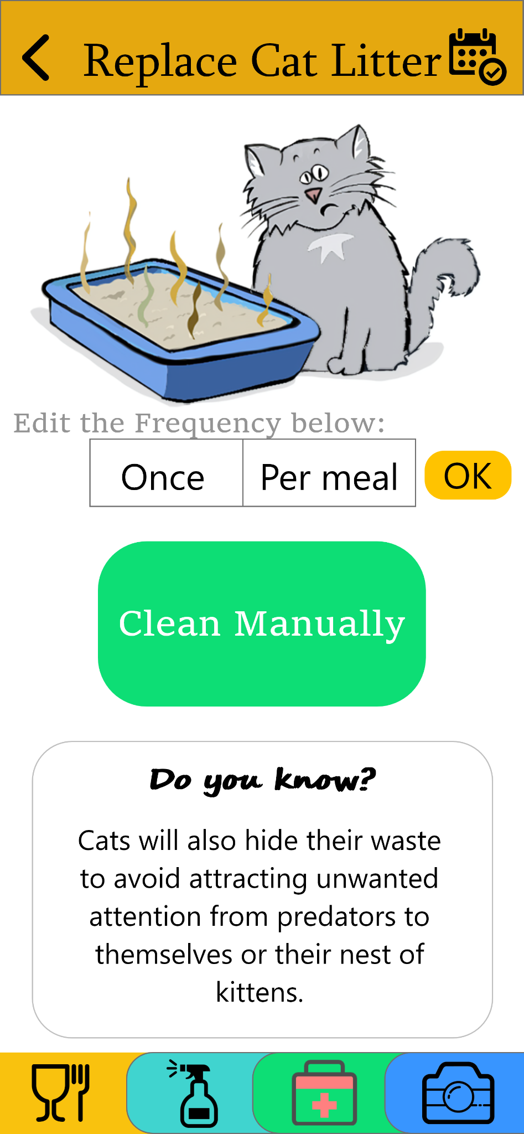
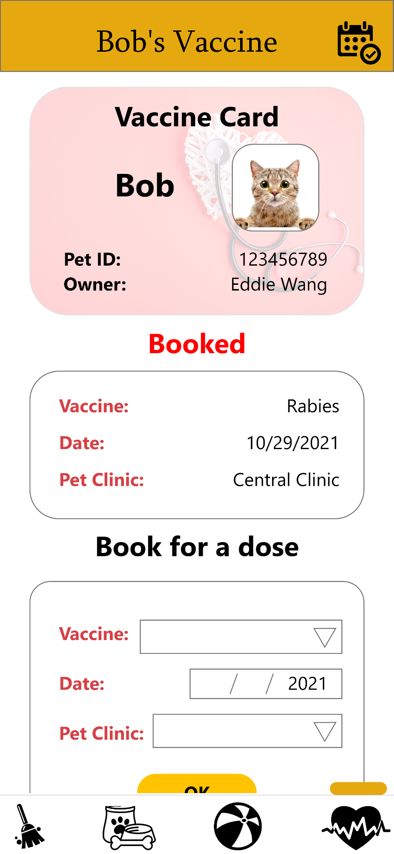
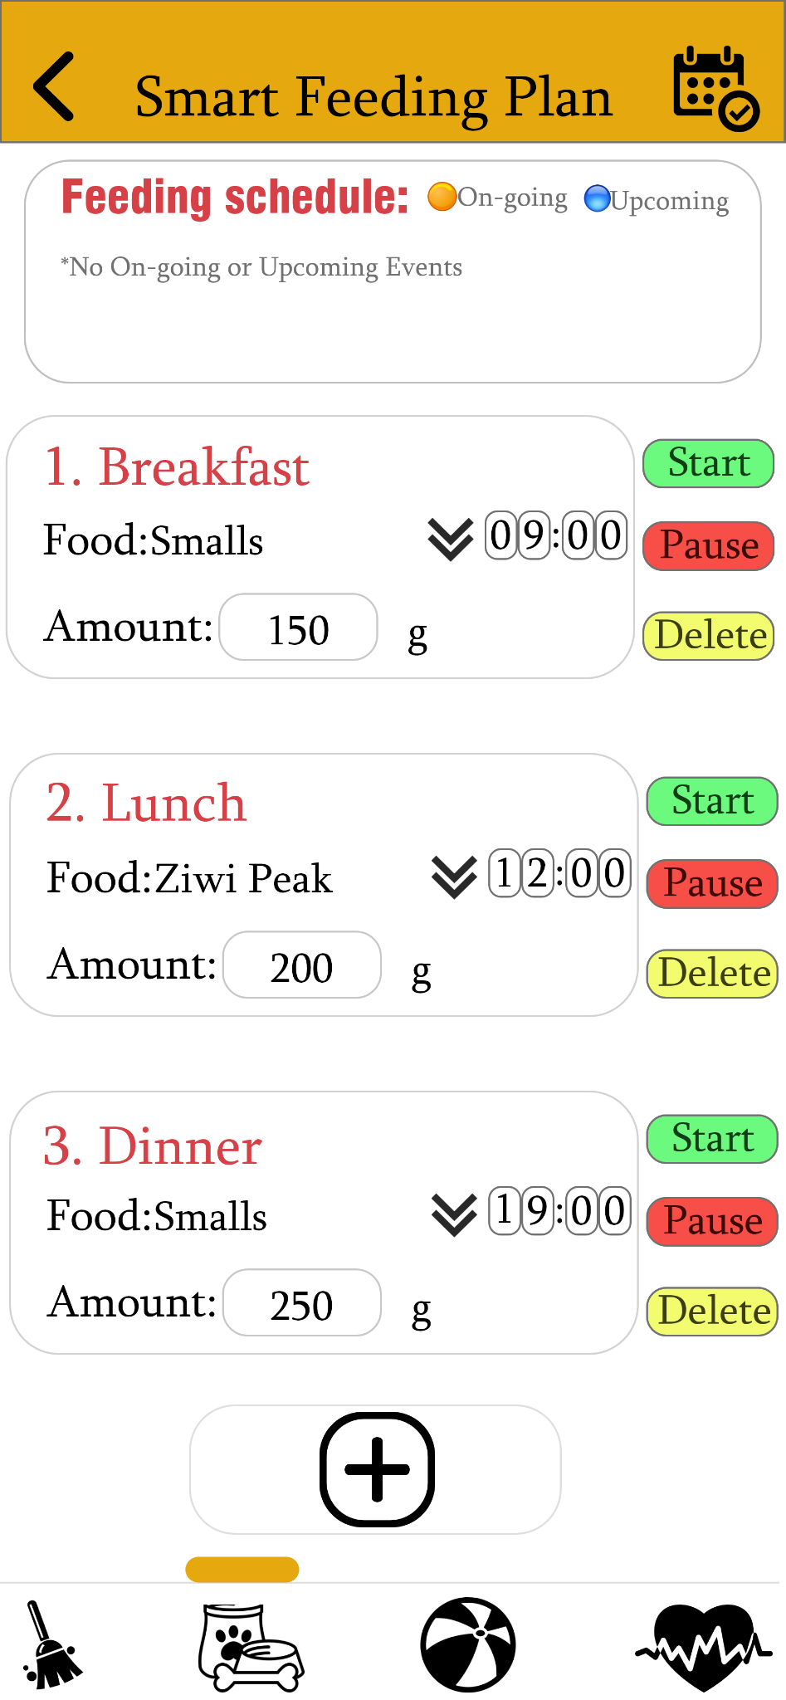
User Evaluation Results
Feeding: Too many buttons; Include an instruction manual; The functionalities meet the expectations.
Cleaning: Some buttons are unclear (e.g. ‘Clean manually’); include a ‘Check cleaning schedule’ function.
Health: Easy navigation; cancelation of the vaccine appointment; Should tell users if the health information is normal.
Interaction: Simple and clear; More control of the camera; Should tell users if the photos and videos are stored successfully.

Slide 8
Reflection
Too many functions in one page can be a problem
The sample size is too small (only 5 participants)
The participants are all university students
A lot of useful feedback and suggestions collected
Limited control of the interface (can be improved if we have more time)

Slide 9
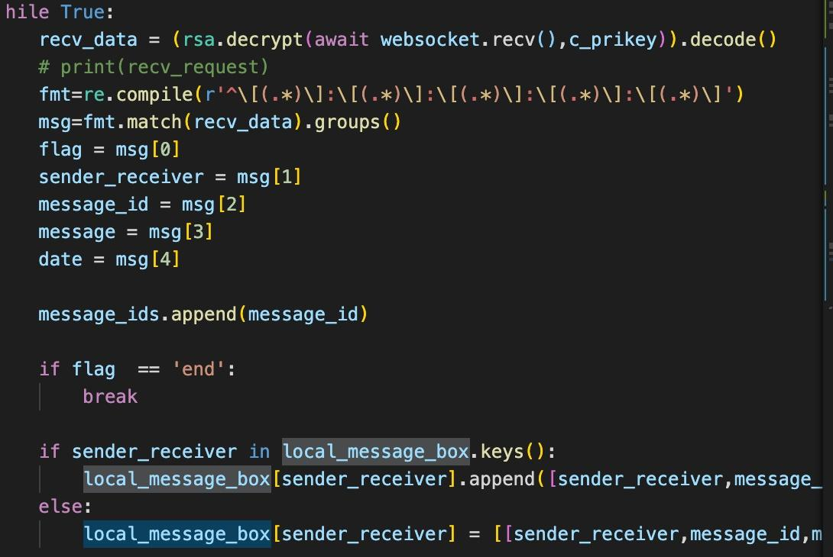
Future Work
More tests
Improvement
Coding

Slide 10

Conclusion Highlighting contributions
Combine and improve features
convenient
More dimensions

Slide 11
Thanks for watching!
Questions?
Thanks for watching!
Questions?

